Slide 1


Week 8 Assignment 1 – First Run Business Model & Storyboard
Capstone A - Week 8 - Team 8
3 July 2021
Vincent Maher, Kyle Frizol, Ruth Ngiendo, Matthew Pearce

Slide 2
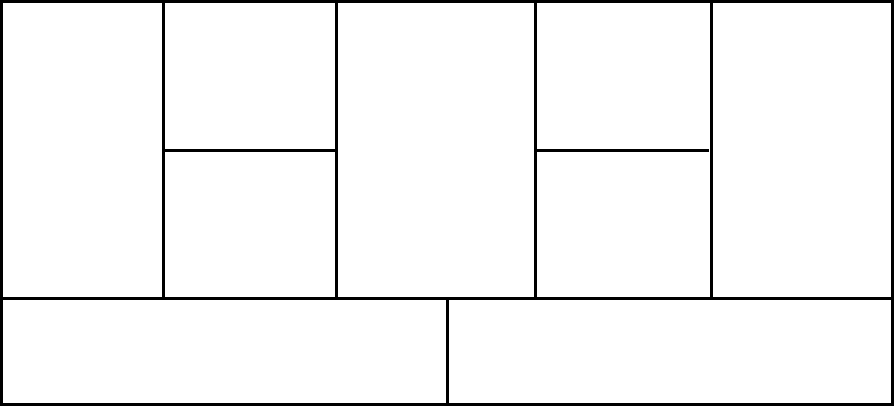
Turnover Management Business Model – "Microsoft Vault"
Key Partners
Key Activities
Value Propositions
Customer Relationships
Customer Segments
Software Support
Software Developers
MS Office Integration
Co-Creation
Platform support
Large organizations
Software Design
Categorized Intake Form
Business Intelligence
Cloud Technology
Software Development
Service Integration
Automated services
Fast-paced project teams
Email reminders to preserve information
Cloud Storage
Key Resources
Channels
MSN Web Portal
High-turnover industries
Azure
System Integrators
IT infrastructure and developers
Microsoft Suite framework
Stored timestamp, project, team, role, other context
Retail
Intuitive search functions
Freelance PC customers
Software Engineers
Microsoft economies of scale
Microsoft Partner Network
Organizational Turnover feedback
Cost Structures
Cloud Computing Costs
Revenue Streams
Consultation and Marketing Costs
Upgrade Costs
OS Upgrade Trial
Advertising Fees
Download Sales
Annual Subscription
Licensing
Software Development Costs
Notes:
*Use colors to show relationships; shows relationships amongst business model.
https://www.cleverism.com/company/microsoft/

Slide 3


Building Block 1: Customer Segments
Who Are Our Customers?
Large Organizations
Target firms with existing Microsoft suite contracts and massive data needs.
High Turnover Industries
Firms that employ high % of contract workers or “churn” employees.
Fast-Paced Project Teams
Teams that need to keep sprinting without interruption in event of a leave.
Freelance PC customers
Accountability for freelance developers, consultants, or graphic designers to preserve their routines, code, and other useful info.

Slide 4


Building Block 2: Value Propositions
What Do We Deliver to the Customer?
Categorized Intake Process
Interface stores timestamp, project, team, role, key words, and context on documents.
Document is submitted and stored with crucial info attached in the intake system.
Email Reminder Integration
Firm sets cadence (weekly, monthly, quarterly).
Emails employees a reminder to submit and preserve work for the vault on timely basis.
Intuitive Search functions
Detailed search page for all intake form categories.
AI can “learn” and pull documents that it expects users to need based on search criteria.
Cloud Storage
Easy to implement storage available via the Azure framework for existing MS customers.

Slide 5

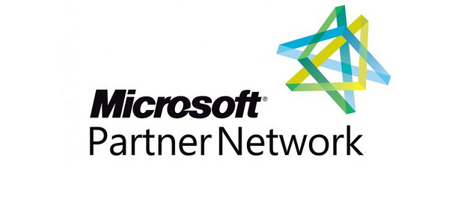

Building Block 3: Channels
Through Which Channels Do Our Customers Want to Be Reached?
Retail
Customers leveraged through existing SaaS consumer markets.
MSN Web Portal
Utilize MSN portal to connect customers with Microsoft Store.
Offer innovative enterprise solution via storefront.
Microsoft Partner Network (MPN)
Community-driven network allows existing Microsoft customers to easily integrate "Vault".
MPN introduces engaging environment that supports service integration and business growth.

Slide 6


Building Block 4: Customer Relationships
What Relationship Do Customers Expect to be Established and Maintained?
Service Integration
Vault's innovative solutions integrate into existing Microsoft platforms.
Automated Services
Workflow processes automate storage and preservation.
Crafted to each customer's preferences and organizational structure.
Co-Creation
Feedback driven iterative process given to Vault solution.
Similar to MPN network.
Specific organizational needs supported.
Platform Support
Users able to continue using existing cloud services alongside Vault.
Microsoft 365
Azure

Slide 7




Building Block 5: Revenue Streams
How and For What are Customers Willing to Pay?
Download Sales
From accessing the Vault features.
Annual Subscription
A per-user fee, monthly or annually, during the subscription term.
Operating System Upgrade Trial
From acquisition of upgrades by key users.
Advertising Fees
Allowing organizations to use the interface for advertising.
Licensing
One time purchase with indefinite rights for customers.

Slide 8

Building Block 6: Key Resources
What Key Resources Do Our Value Propositions Require?
IT infrastructure and developers
Using IT resources and developers to build the front-end interfaces, back-end storage, and AI (MS Azure) integration.
Microsoft Economies of Scale
Large liquid capital resources already allocated to new development work.
Business partnerships to leverage, from a customer and distribution standpoint.
Microsoft Suite Framework
Ease of implementation by including in the MS Suite line of products.
Easily added or dropped by customers to new or existing Suite contracts.
Payment management interface already intuitively designed with needs in mind

Slide 9
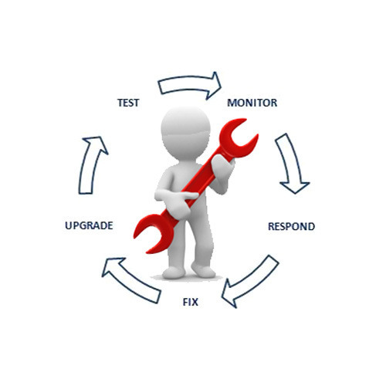



Building Block 7: Key Activities
What Key Activities Does Our Value Proposition Require?
Design
Define and develop application requirements and architecture.
Software Development
Plan, design, test, implement, deploy and maintain.
Support
Technical support; remote troubleshooting; application guides.

Slide 10




Building Block 8: Key Partnerships
Who Are Our Key Partners?
Software Engineers
Program and build Microsoft "Vault" interface.
Developers
Provide initial and continuous system analysis.
Develop and implement patch updates and refinements.
System Integrators
Integration of Microsoft "Vault" into current MS Office structure.
Cloud Technologies

Slide 11

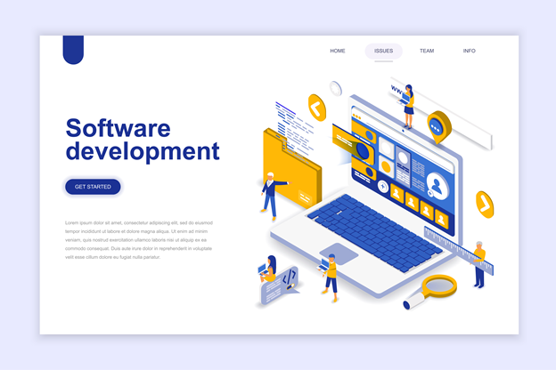

Building Block 9: Cost Structure
What Are the Most Important Costs Inherent to Our Model?
Cloud Computing costs
Associated with delivering cloud computing services for data preservation and the management of the technology.
Software Development cost
Incorporating the need for software developers and engineers in creating and improving a Vault.
Consultation and Marketing cost
Associated with consultation with Business intelligence companies and creating awareness of the Vault.
Turnover management and upgrade Cost
Serves as costs incurred on improvement and additional initiatives required for the vault effective process.

